Slide 1
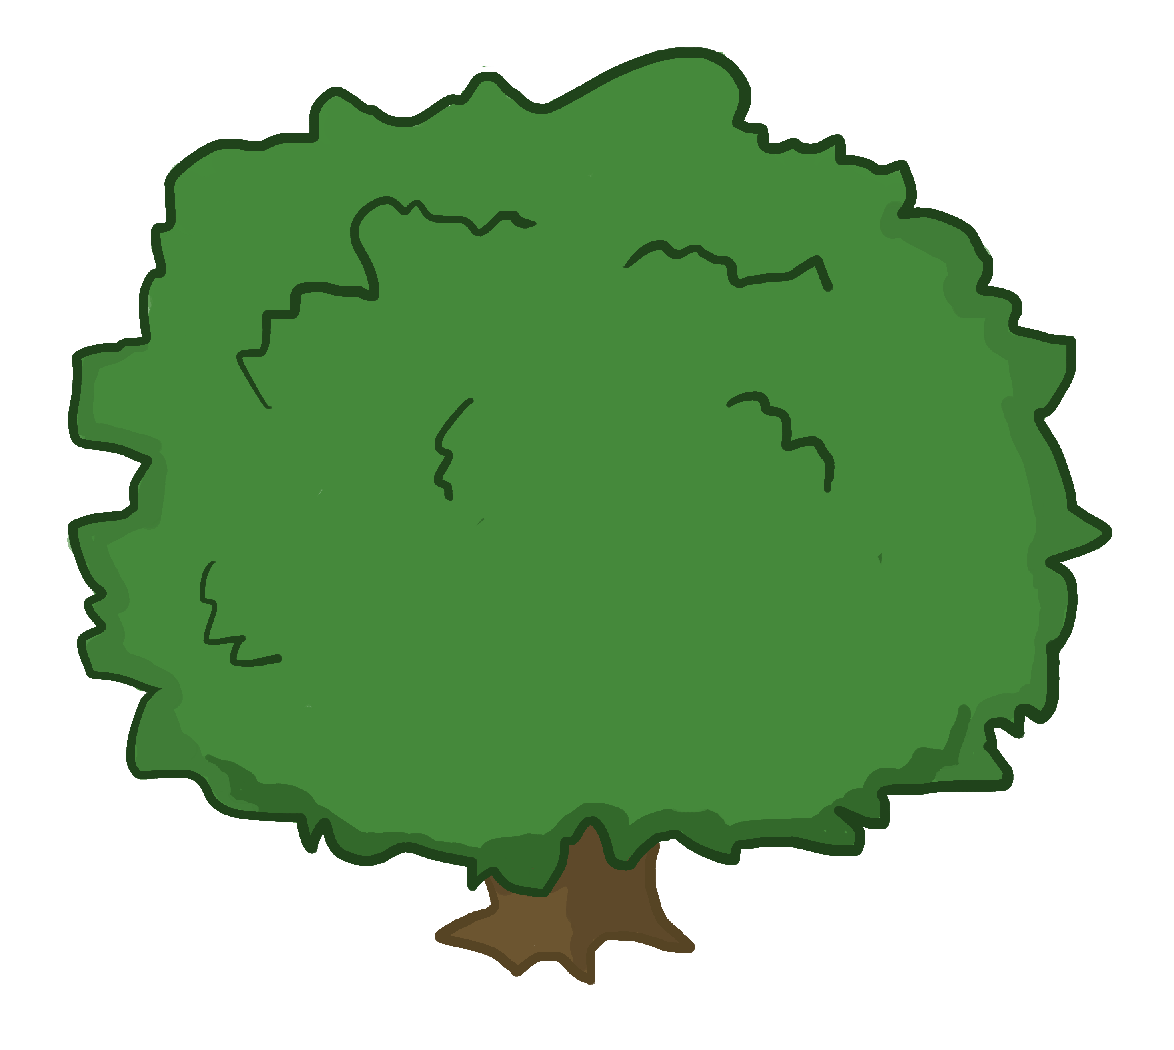
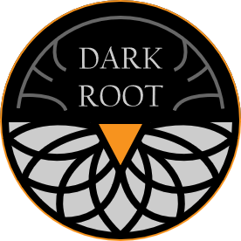
Carrot Quest The Root of Evil
STYLE GUIDE

Slide 2
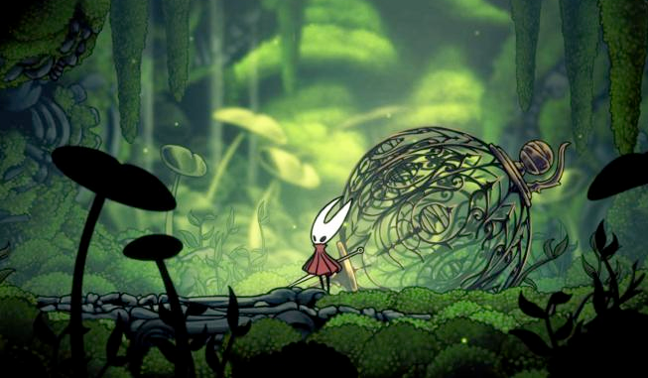
WORLD
A nature filled world with darkness and corruption lurking behind the corners. What nature? Forest? Green land? How has it been corrupted by the curse?
Hollow Knight style lineart and cell shading, enhanced with painterly elements

Slide 3
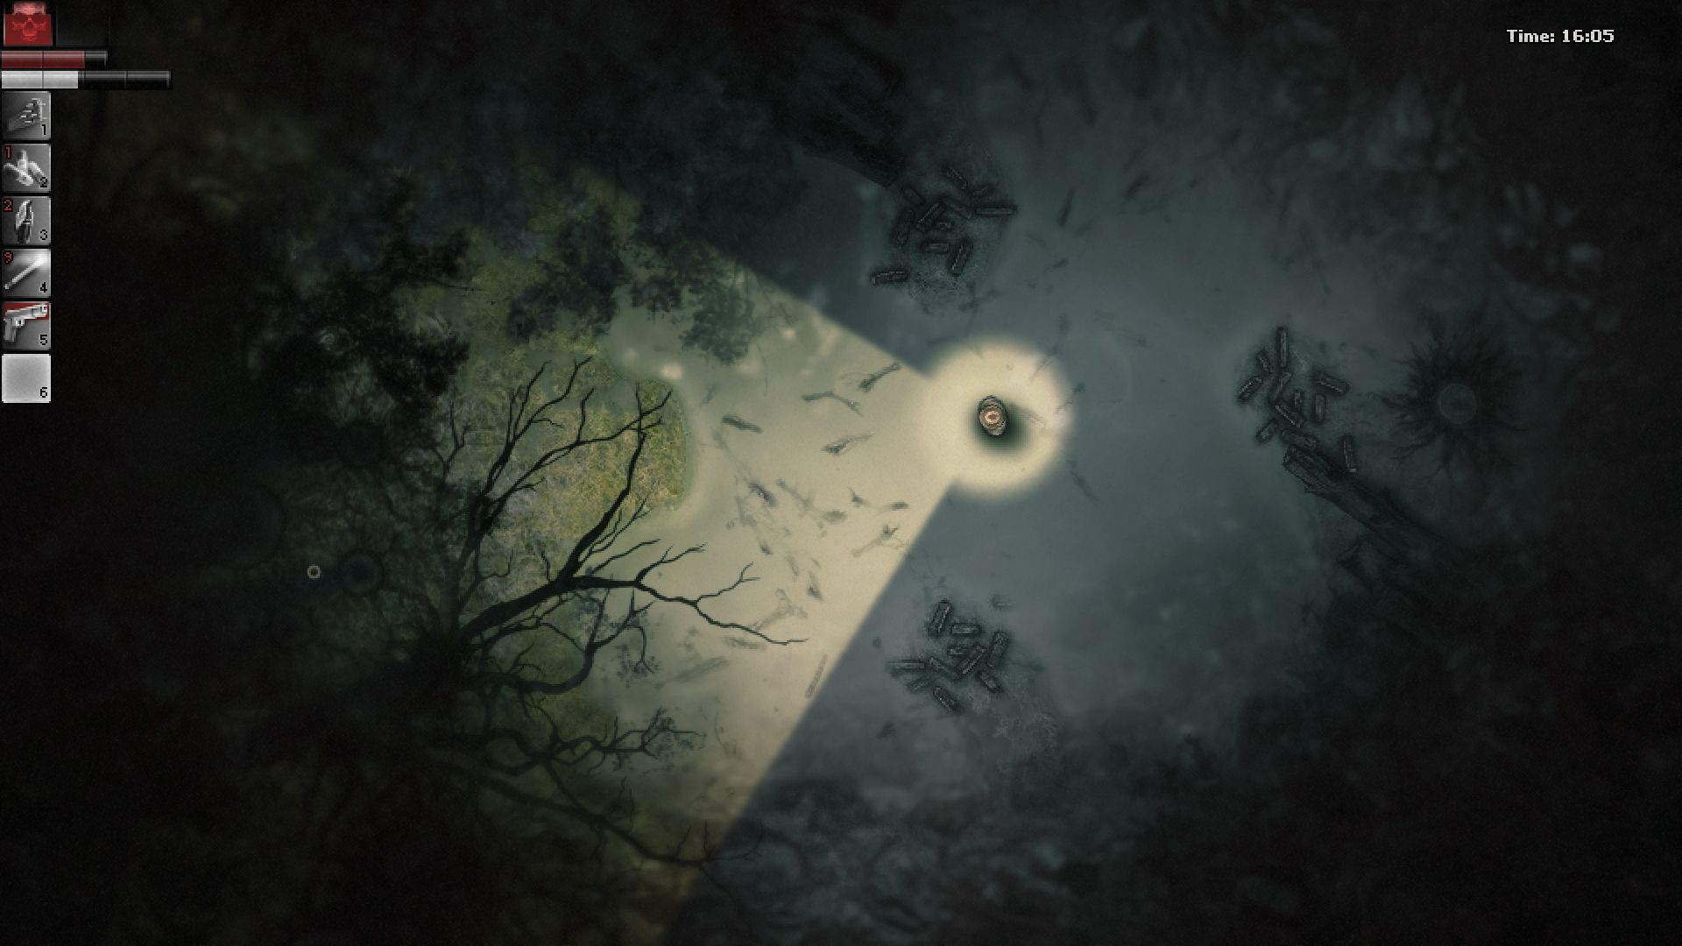
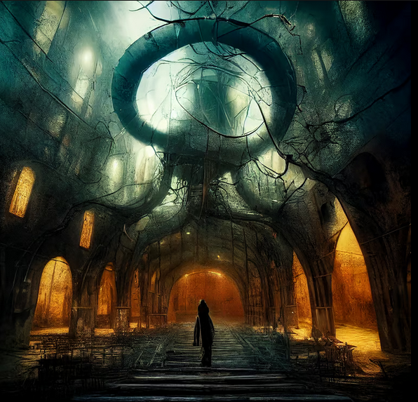
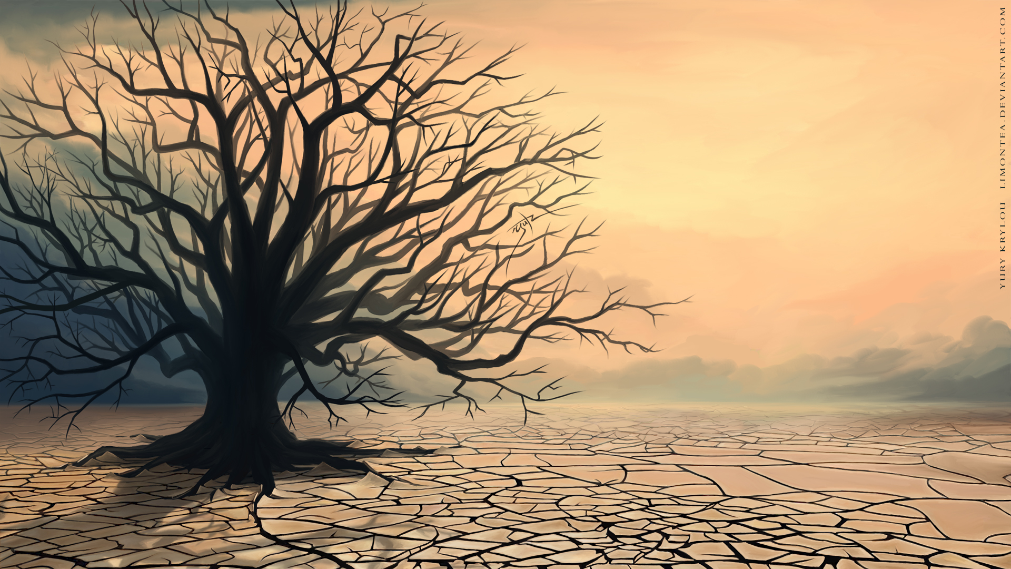
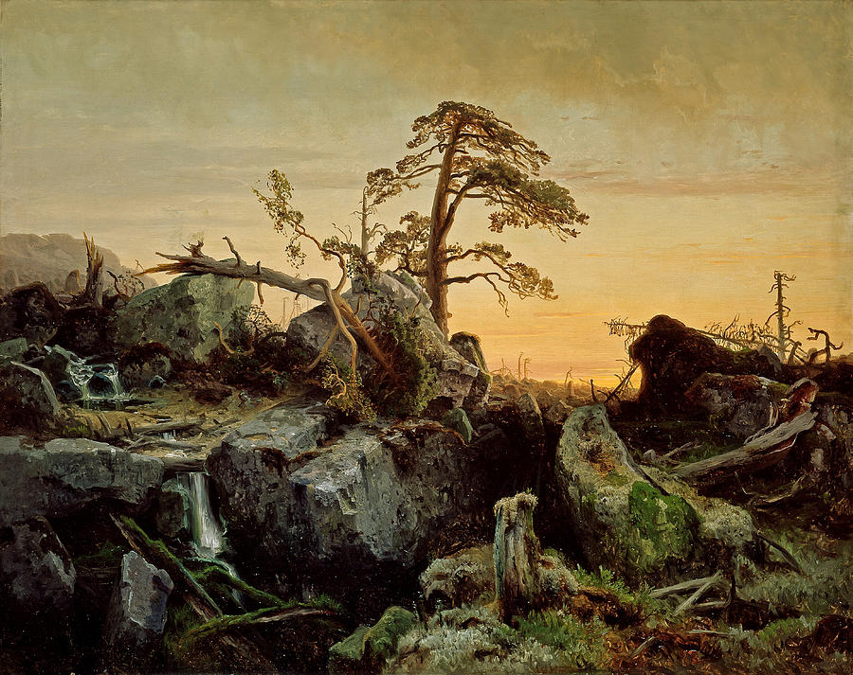
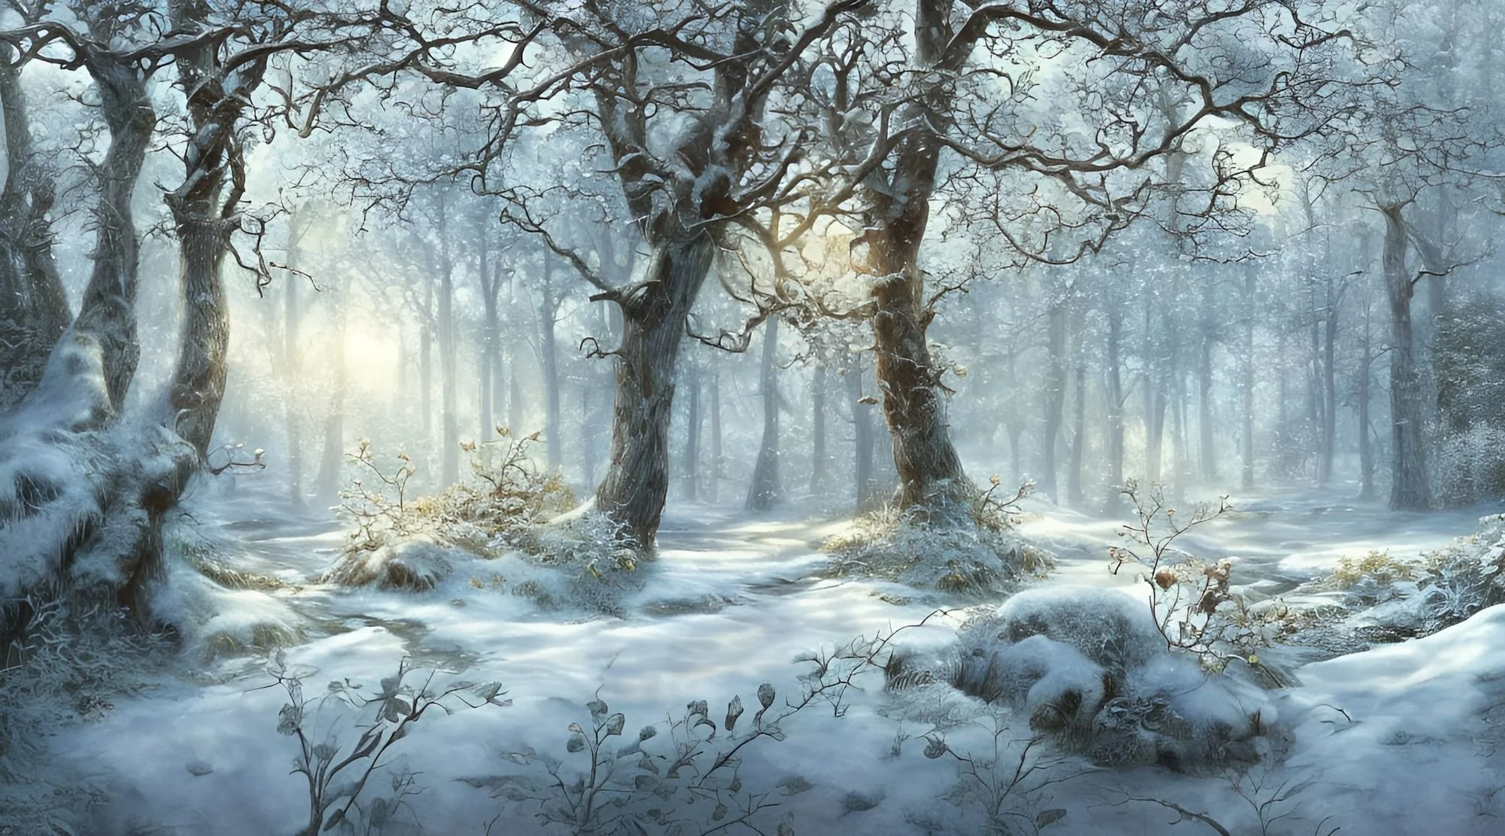
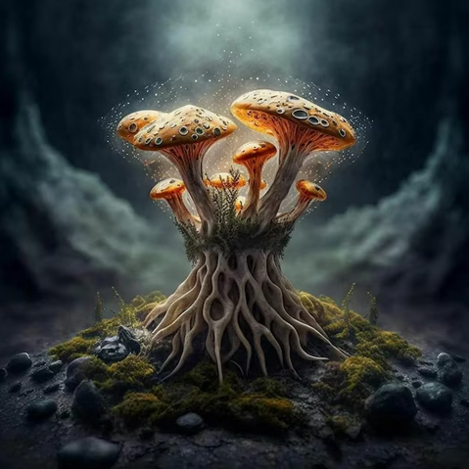
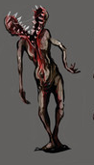
ENVIRONMENT
Reflects the natural world, with evidence of decay and corruption decay of the land? Decay of the vegetation? What specifically
Both darkness and color coexist what color palette specifically?
The beautiful elements of an environment combined with the horrific what horrific? The cursed bunnies?

Slide 4
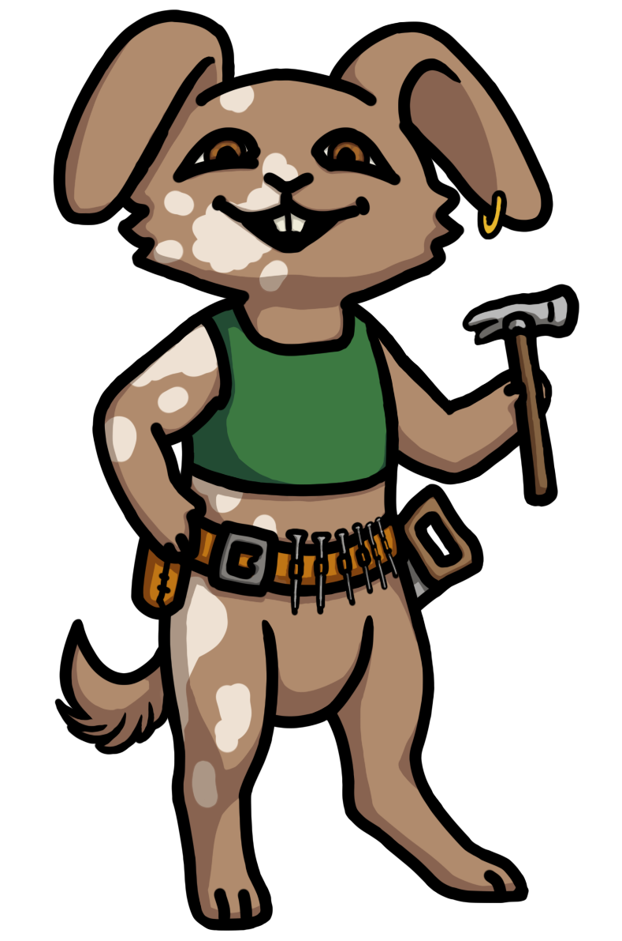
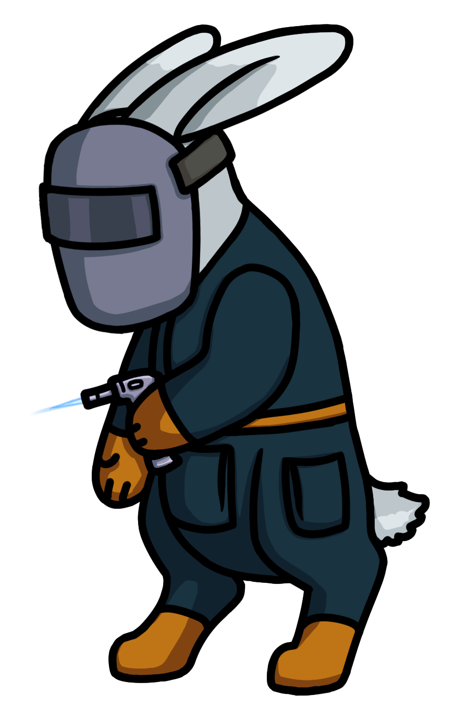
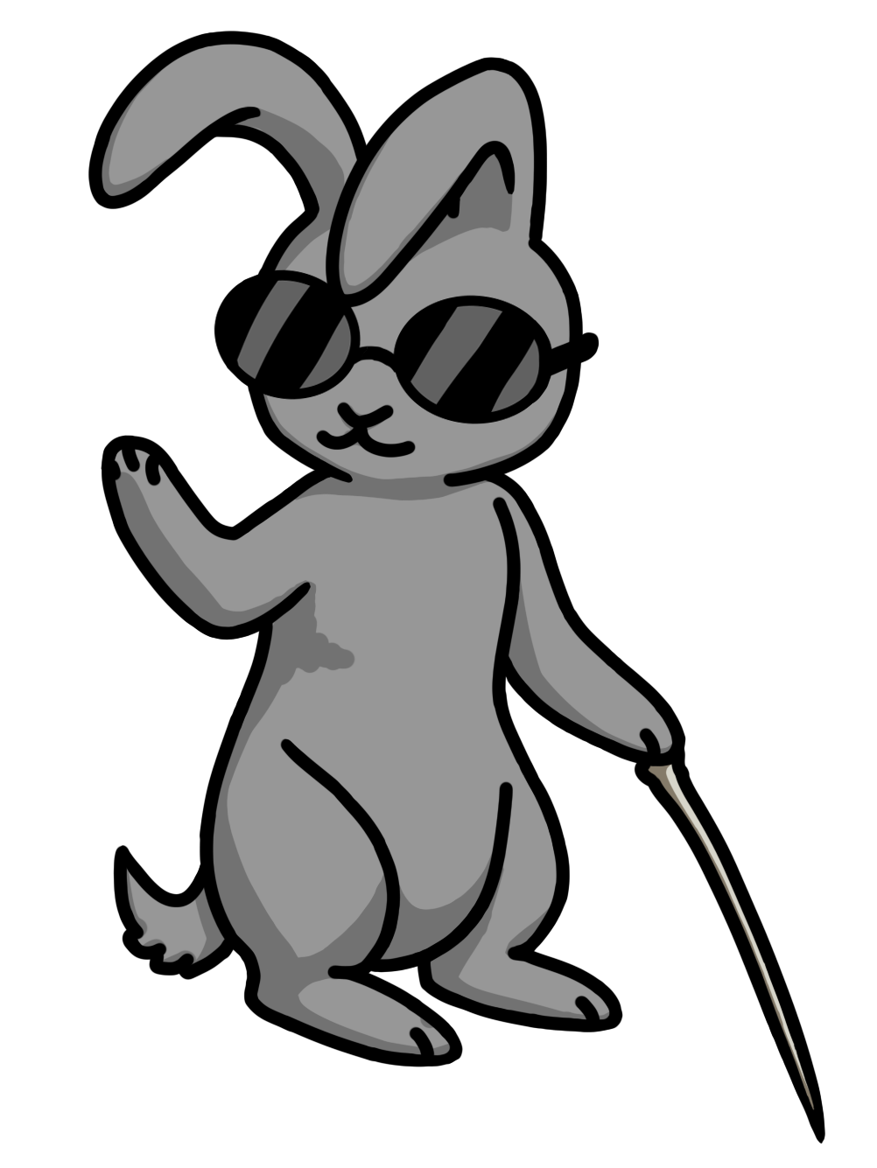

CHARACTERS
Upright, confident pose and smile shows Oakly’s cheerful and capable personality
Slightly turned away, a bit hunched. Shows Dewdrop’s more nervous personality.
Black outlines over cell shaded art
Bunnyville bunnies are friendly and look soft
A character’s idle pose should reflect their personality

Slide 5
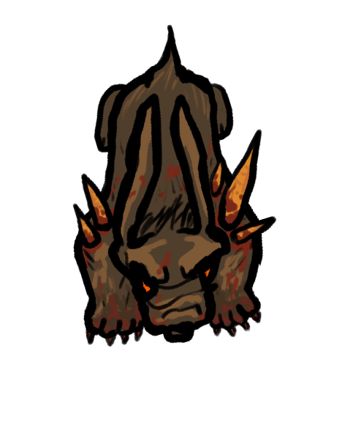
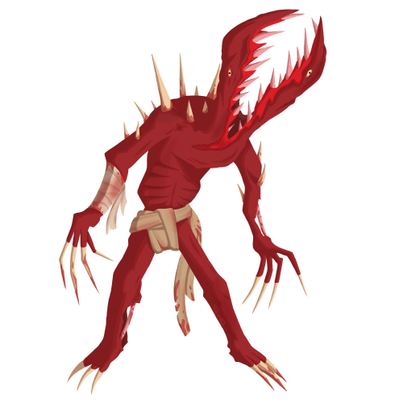
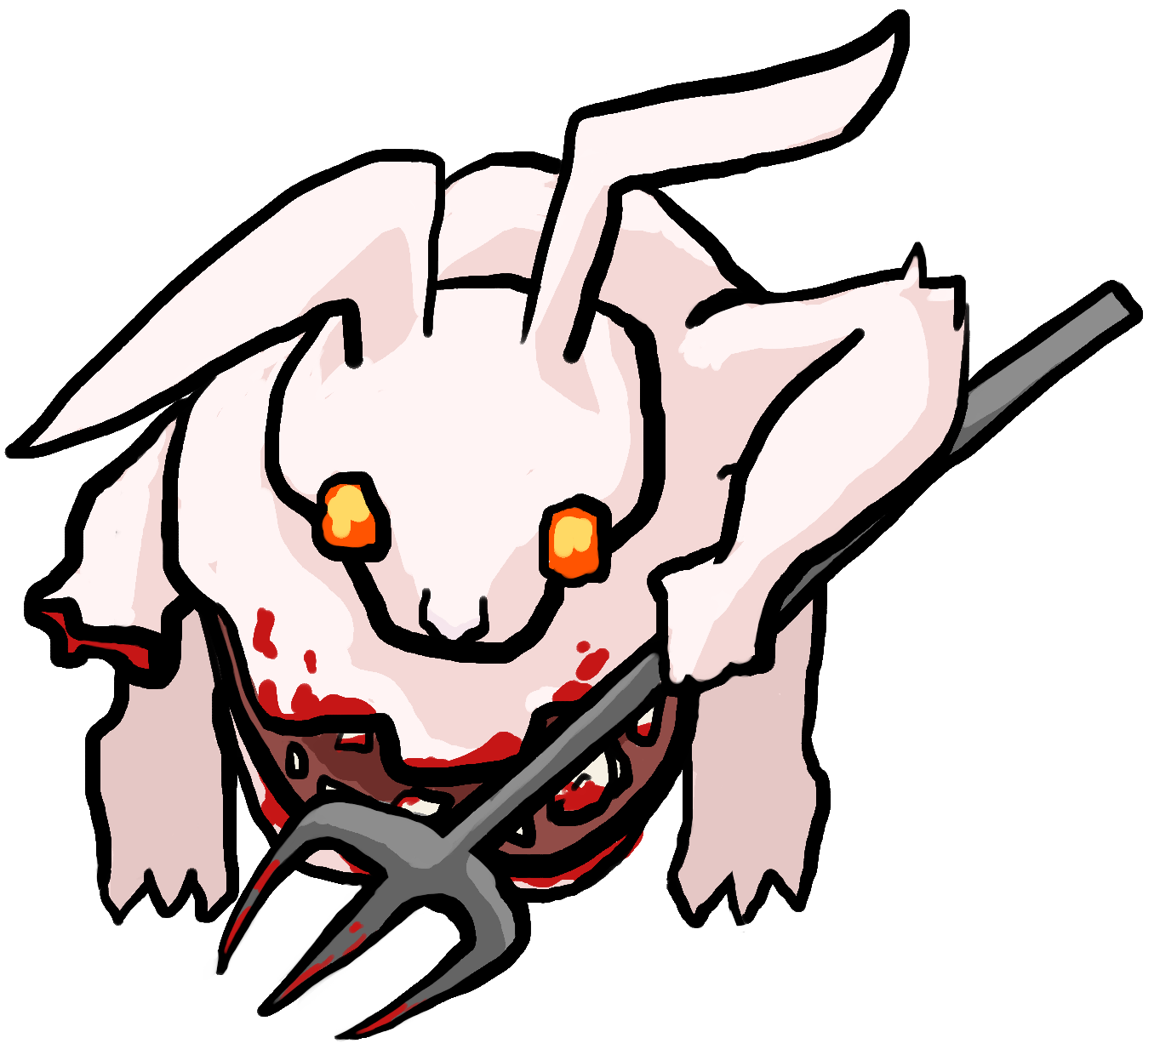
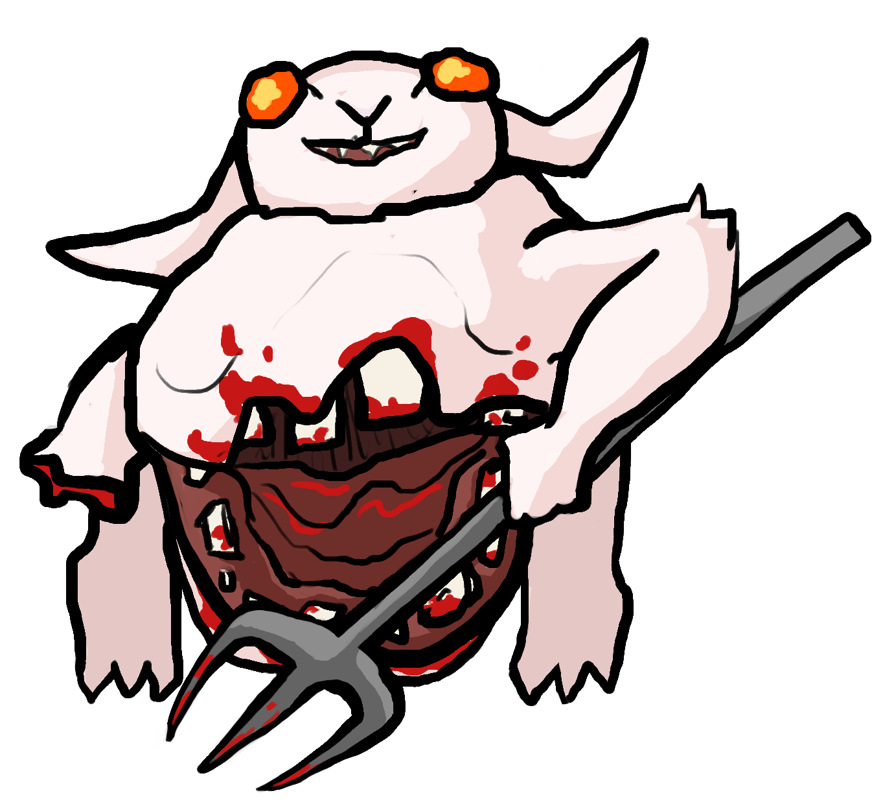
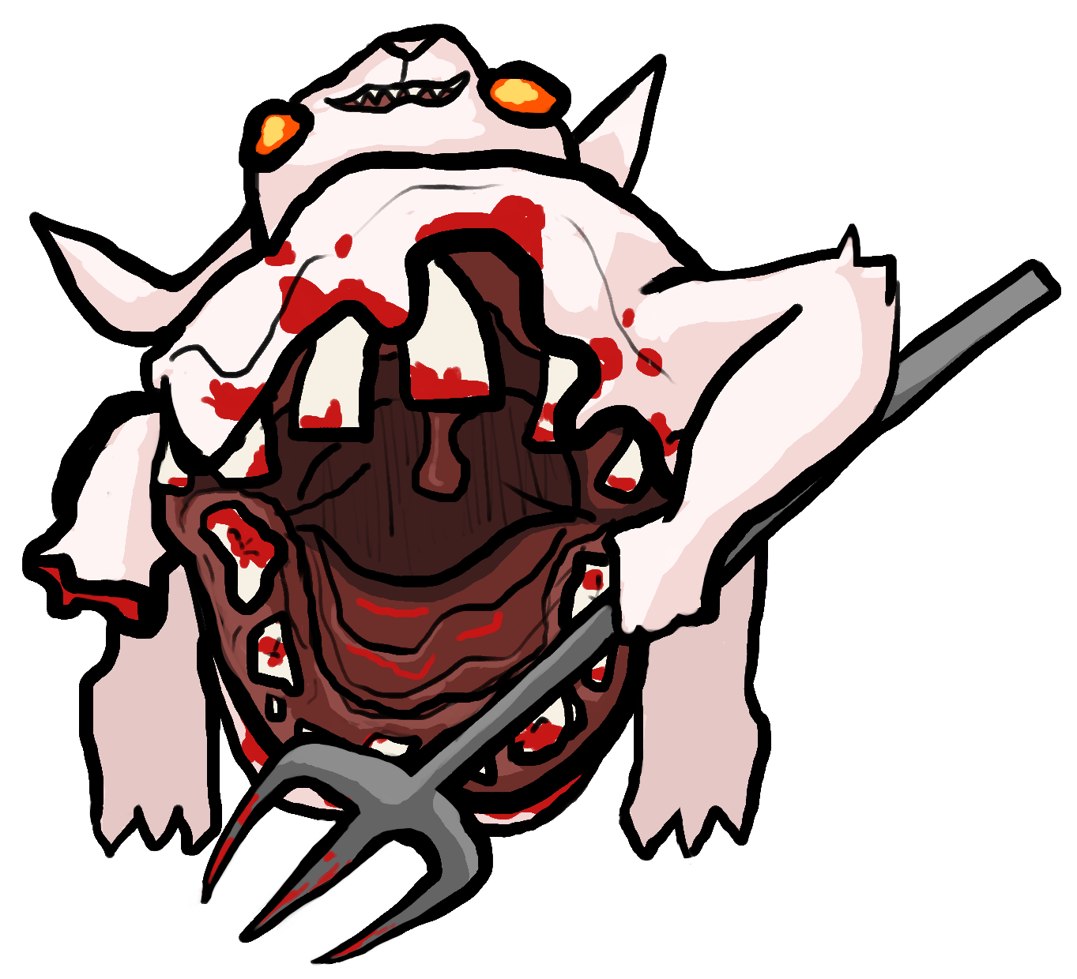
ENEMIES
Carrots growing out show the horror of the Carrot Curse
Black outlines over cell shaded art
Enemies mutated by the Carrot Curse are often zombie-like, with blood or warped bodies
Carrots often feature in the designs, as if they are growing through the cursed enemies
Enemies should have unique mutations reflecting their attack style and environment
Large mouth reflects massive melee attack style, and distinctive roar to summon allies

Slide 6
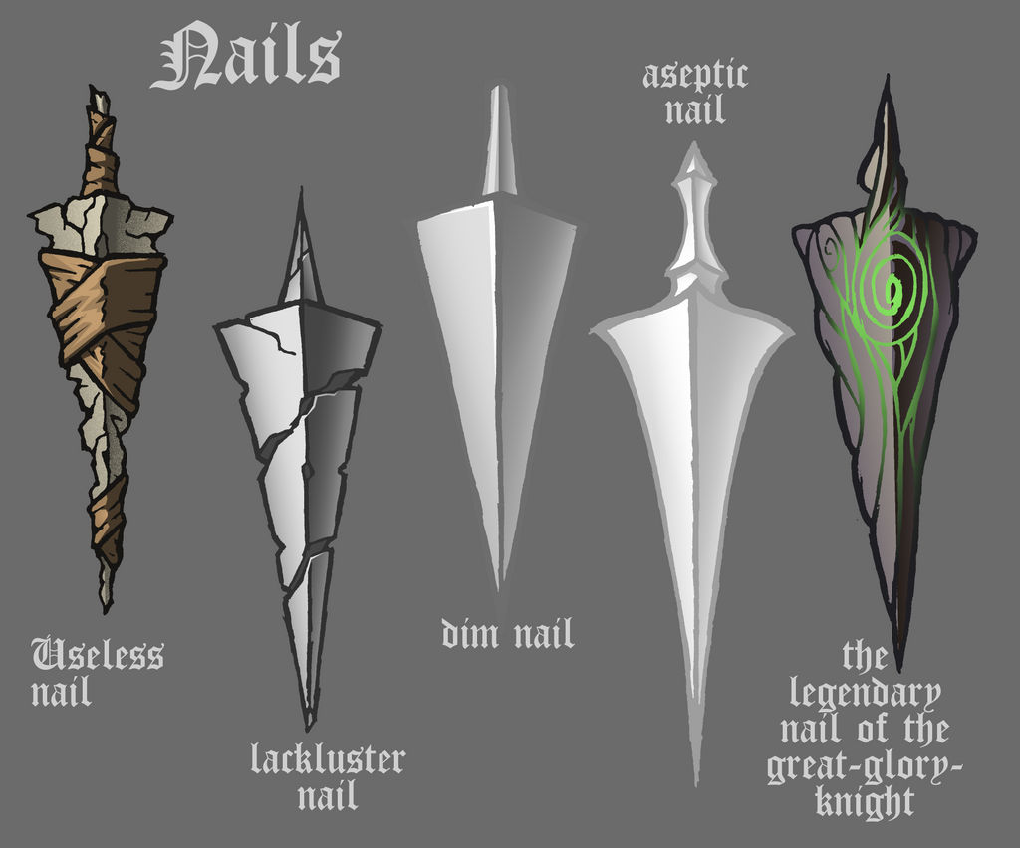


OBJECTS
Communicate the uniqueness of the item, while keeping the design simple
The currency, Carrot Seeds, is a simple rotating triangle
Other dropped items have black outlines and are cell-shaded, or have simple gradients
Powerups will not be outlined, to better enhance their unique visuals

Slide 7
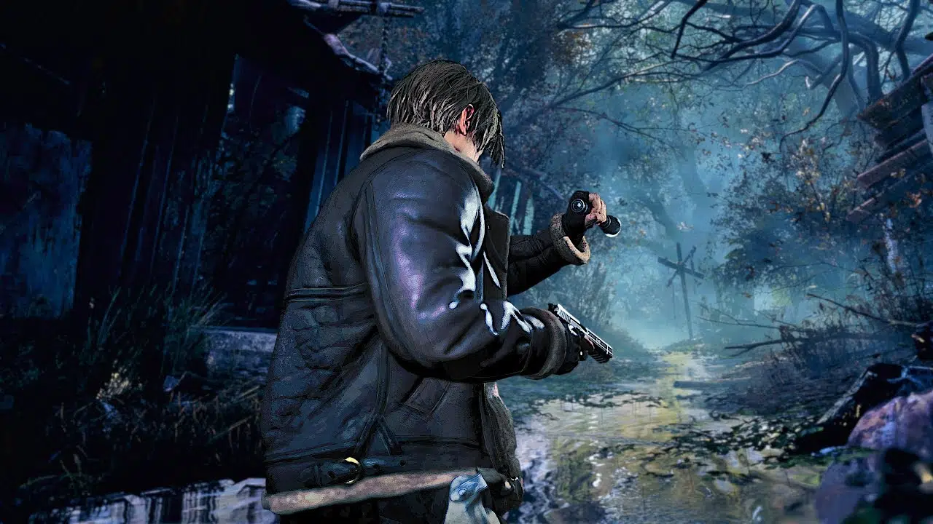
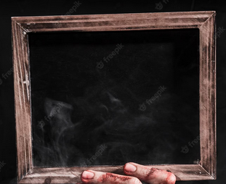
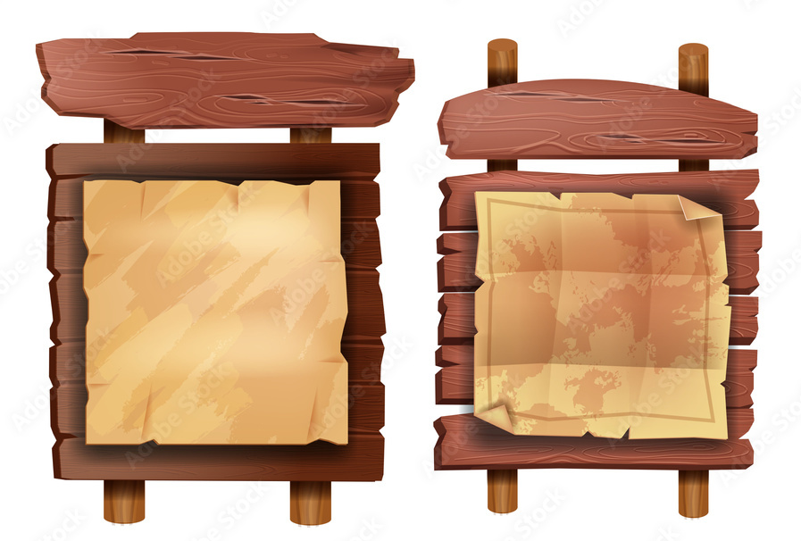
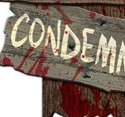
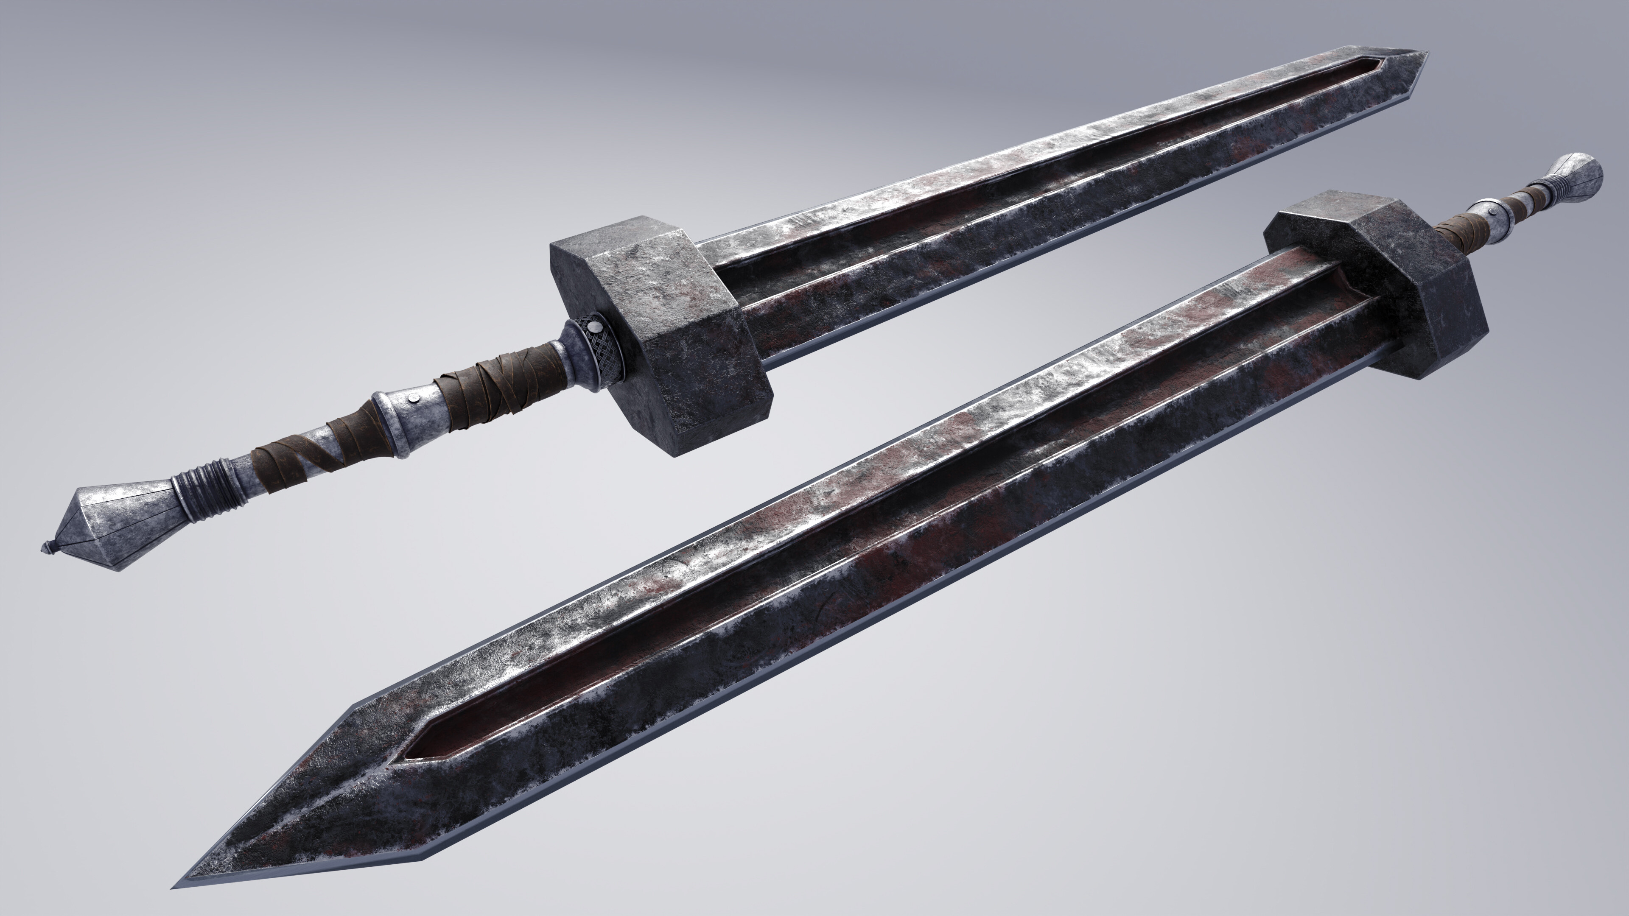
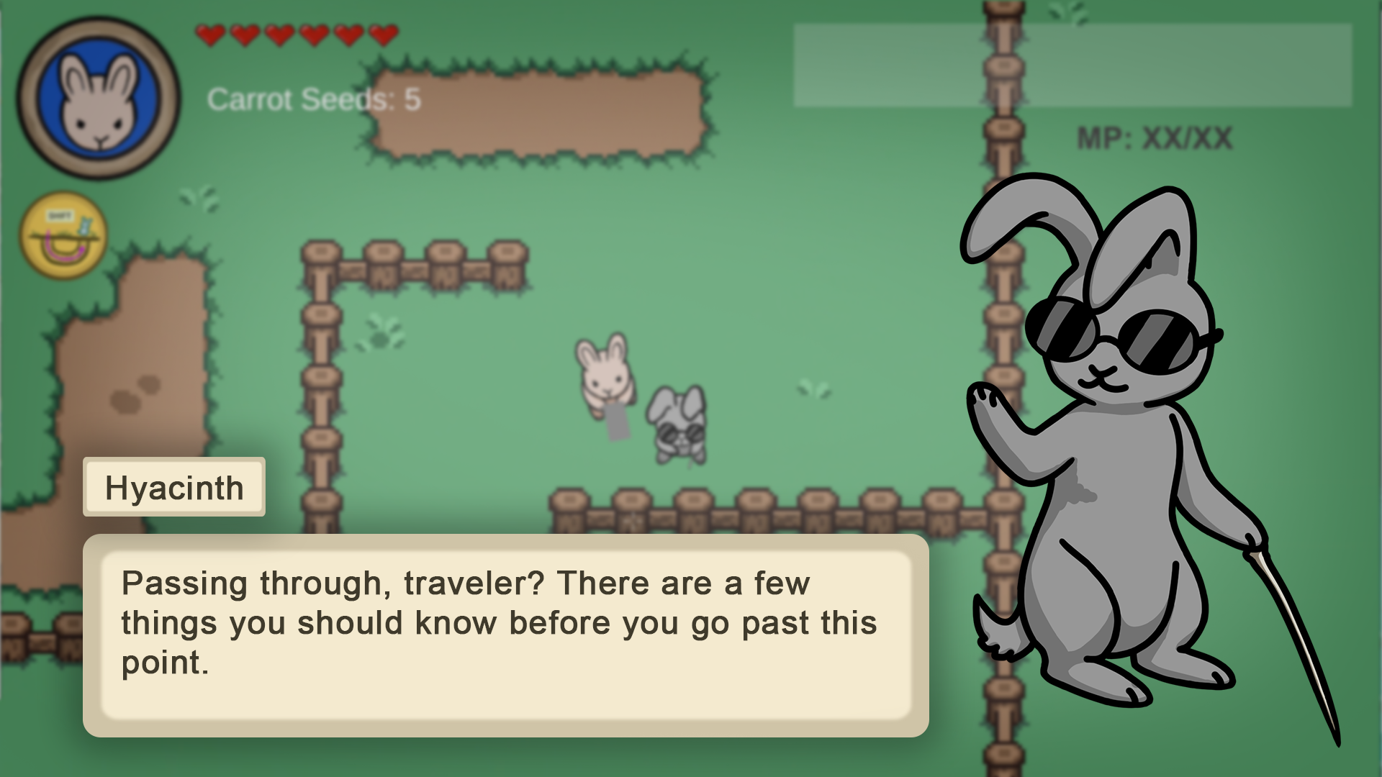
UI
Matching with the general aesthetics of the game, the UI will be outlined in black, or a dark brown
UI should feel “village rustic” with some rust and blood thrown in to show corruption in a resident evil 4 type of way? Do you want things to be shown to be old, broken from the outbreak of cursed bunnies? Is the blood subtle, overt?

